Slide 1


Computer
Lecture 6
Dr. Nada Abdullah Rasheed
Assist prof. / Computer Science

Slide 2
Syllabus Content
Subject | Lec. No.
Output Devices | 5

Slide 3
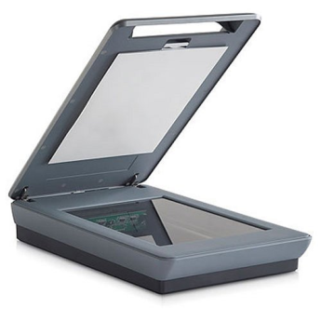
Scanner
The scanner is an input device, which works more like a photocopy machine. It is used when some information is available on paper and it is to be transferred to the hard disk of the computer for further manipulation. The scanner captures images from the source which are then converted into a digital form that can be stored on the disk. These images can be edited before they are printed.
Digitizer
Digitizer is an input device which converts analog information into digital form. The digitizer can convert a signal from the television or camera into a series of numbers that could be stored in a computer. They can be used by the computer to create a picture of whatever the camera had been pointed at. Digitizing is also known as Tablet or Graphics Tablet as it converts graphics and pictorial data into binary inputs. A graphic tablet as digitizer is used for fine works of drawing and image manipulation applications.

Slide 4

Microphone
The microphone is an input device to input sound that is then stored in a digital form. The microphone is used for various applications such as adding sound to a multimedia presentation or for mixing music.

Slide 5
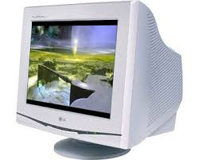
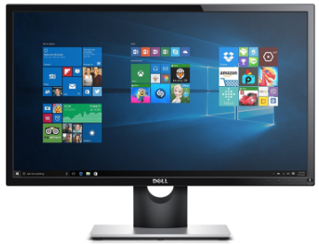
Output Devices
Following are some of the important output devices used in a computer. Monitors Graphic Plotter Printer:
Monitors
Monitors, commonly called as Visual Display Unit (VDU), are the main output device of a computer. It forms images from tiny dots, called pixels that are arranged in a rectangular Form. The sharpness of the image depends upon the number of pixels. There are two kinds of viewing screen used for monitors: Cathode-Ray Tube (CRT), and the Flat-Panel Display.
Cathode-ray Tube (CRT) Monitor
Flat-Panel Display Monitor

Slide 6
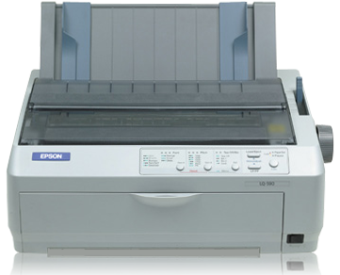
Printers
The Printer is an output device, which is used to print information on paper. There are two types of printers: Impact Printers and Non-Impact Printers.
Impact Printers
Impact printers print the characters by striking them on the ribbon, and then pressed on the paper. Characteristics of Impact Printers are the following: Very low consumable costs, Very noisy Useful for bulk printing due to low cost, there is physical contact with the paper to produce an image. These printers are of two types: Character printers, which print one character at a time and Line printers.

Slide 7
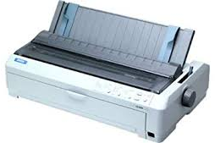
Dot Matrix Printer
In the market, one of the most popular printers is Dot Matrix Printer. These printers are popular because of their ease of printing and economical price. Each character is printed in the form of a pattern of dots and head consists of a Matrix of Pins of size (5*7, 7*9, 9*7 or 9*9) which comes out to form a character which is why it is called Dot Matrix Printer.
Advantages: Inexpensive, Widely Used, Other language characters can be printed.
Disadvantages: Slow Speed and Poor Quality.

Slide 8
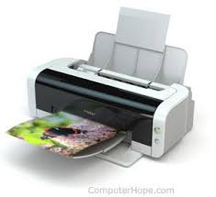
Non-impact Printers
Non-impact printers print the characters without using the ribbon. These printers print a complete page at a time, thus they are also called as Page Printers. These printers are of two types - Laser Printers Inkjet Printers Characteristics of Non-impact Printers Faster than impact printers. They are not noisy, High quality, Supports many fonts and different character size.

Slide 9
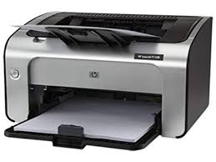
Laser Printers
These are non-impact page printers. They use laser lights to produce the dots needed to form the characters to be printed on a page. Advantages: Very high speed, Very high quality output, Good graphics quality, Supports many fonts and different character size Disadvantages: Expensive, cannot be used to produce multiple copies of a document in a single Printing.

Slide 10
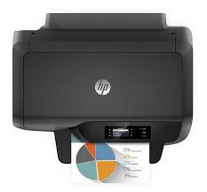
Inkjet Printers
Inkjet printers are non-impact character printers based on a relatively new technology. They print characters by spraying small drops of ink onto paper. Inkjet printers produce high quality output with presentable features.
They make less noise because no hammering is done and these have many styles of printing modes available. Color printing is also possible.
Advantages: High quality printing and more reliable

